Slide 1

Pesticide Water Calculator Training Discussion for SFIREG EQI Working Committee
September 2026
Dirk Young, Environmental Fate and Effects Division
Office of Pesticide Programs

Slide 2
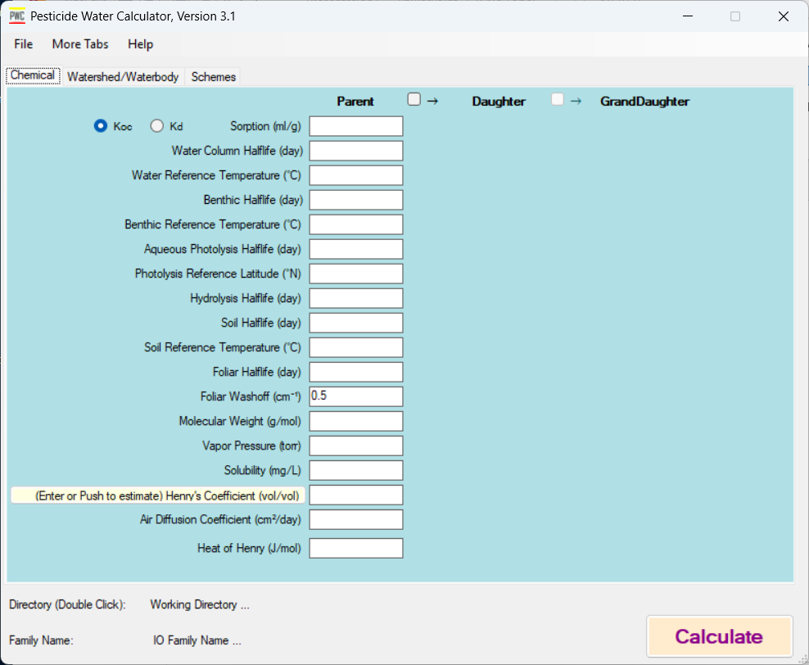
Training Topic: PWC Concept and Tool

Slide 3
Estimated Training Times
Time | Competency
1 hours | Overview of PWC Concepts
2 hours | Above + Chemical Inputs + Simple PWC Run
4 hours | Above + Scenario Development + Schemes + Typical PWC Run
8 hours | Above + Mechanistic Understanding of PRZM/VVWM
Any of the training options will need the approval of OCSPP senior management.

Slide 4
One Hour
Conceptual model overview
Discussion of Field processes, emphasis on runoff, erosion, drift
Discussion of Water Body Types available in PWC
Populate PWC with pre-derived chemical parameters
Run Model, Examine output
Competency: Be able to articulate what the PWC can do. Won’t have skills to run model without expert assistance.

Slide 5
Two Hours
Everything in One Hour plus
Understanding of chemical input parameters sources
Introduction to Schemes
  Pesticide Application Methods
  Scenarios
Learn function to populate all tabs of model
Hands-On Simple model run and obtain output
Competency: Run PWC with pre-provided inputs, find output files and understand the most important records within

Slide 6
4 Hours
Everything previous plus
Field mechanisms: runoff, leaching, degradation
Scenario Development
Waterbody Mechanisms
Waterbody Development
Output Files and Advanced Output
Hands On Computer Runs
Competency: create field scenario and waterbody with pre-provided data. Make a complete PWC run and obtain advanced output

Slide 7
8 hours
Everything previous plus Advanced Features:
Batch Scenario
Special Water Bodies
Application Windows
Mitigation Features
Advanced Output Tab
Interpreting Output
Easy trouble shooting techniques
Competency: Fully capable user

